Slide 1
SMART AGRICULTURE

Slide 2
BLOCK DIAGRAM:
Power supply
Temperature sensor
Motor
Air quality sensor
ESP32
Moisture sensor
OUTPUT
Humidity sensor

Slide 3
COMPONENTS:
ESP32
TEMPARATURE SENSOR(LM35)
AIR QUALIFIER SENSOR(MQ-135)
MOISTURE SENSOR(YL-69 / HL16)
DC MOTOR
HUMIDITY SENSOR(DHT-11)
Arduino software

Slide 4
WORKING:
All the sensors are interfaced with ESP32
The readings from all the sensors are send to the cloud.
When the soil moisture level is below the threshold value then the motor automatically starts working, else motor is off.
Sensor data will be displayed in the webpage.

Slide 5
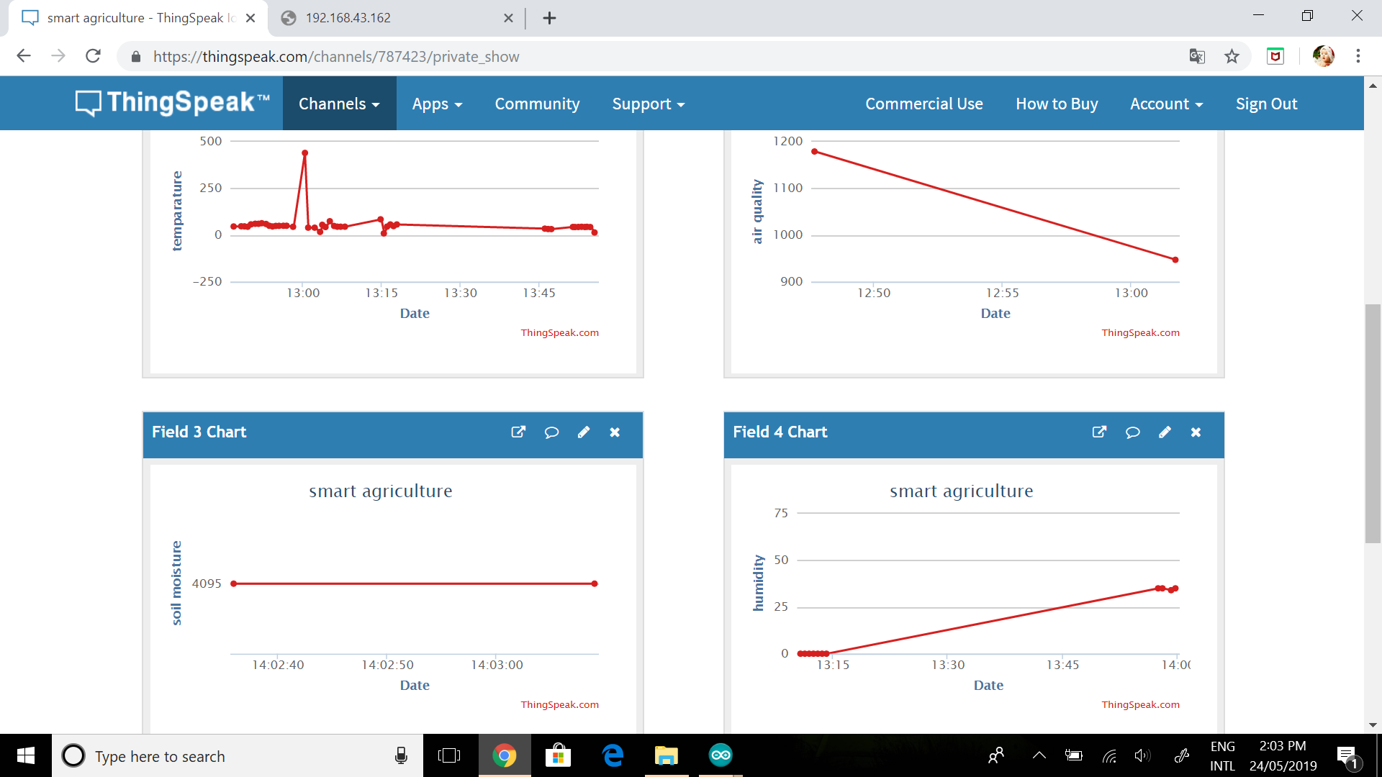

Slide 6
Applications:
Farmer can be able to monitor the field at any place

Slide 7
THANK YOU

